Slide 1
Introduction to C++
Course Code: CSE-2218
Data Structure and Algorithms II Lab
Lec Saifur Rahman
Email: saifur@cse.uiu.ac.bd
Mobile: +8801303529289

Slide 2
What is C++?
“C makes it easy to shoot yourself in the foot;
C++ makes it harder, but when you do it blows your whole leg off.”
C++ is a high-level Object Oriented Programming language with sufficient lower-level functionality (in-line assembly code, access to memory locations, etc)
C++ is (almost exactly) a superset of C
At a high level: C++ ≈ (C + OOP)

Slide 3
Why learn C++ over C?
Everything you did in C can be done using C++.
C++ supports OOP features.
C++ supports and allows user-defined operators (i.e. Operator Overloading) and function overloading is also supported in it.
Exception Handling
The concept of Constructors and Destructors for Objects.
Inline Functions in C++ instead of Macros in C language.

Slide 4
Features of OOP
Data Abstraction
Encapsulation
Inheritance
Polymorphism
Messaging

Slide 5
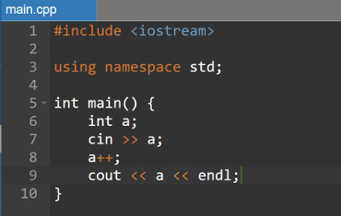
C++ Program Structure
.cpp is the file extension.
Line 1-3: Preprocessor directives.
Lines beginning with # are preprocessor commands
Include the header file for functions like cin, cout, etc
Set the default namespace as standard
Line 5: Entry point of the program. Begin execution here.
Line 6-10: Body of the program.

Slide 6
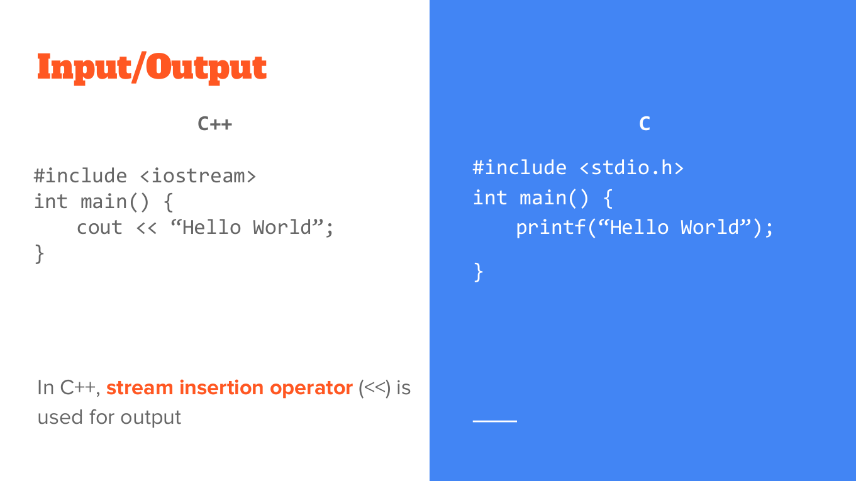

Slide 7
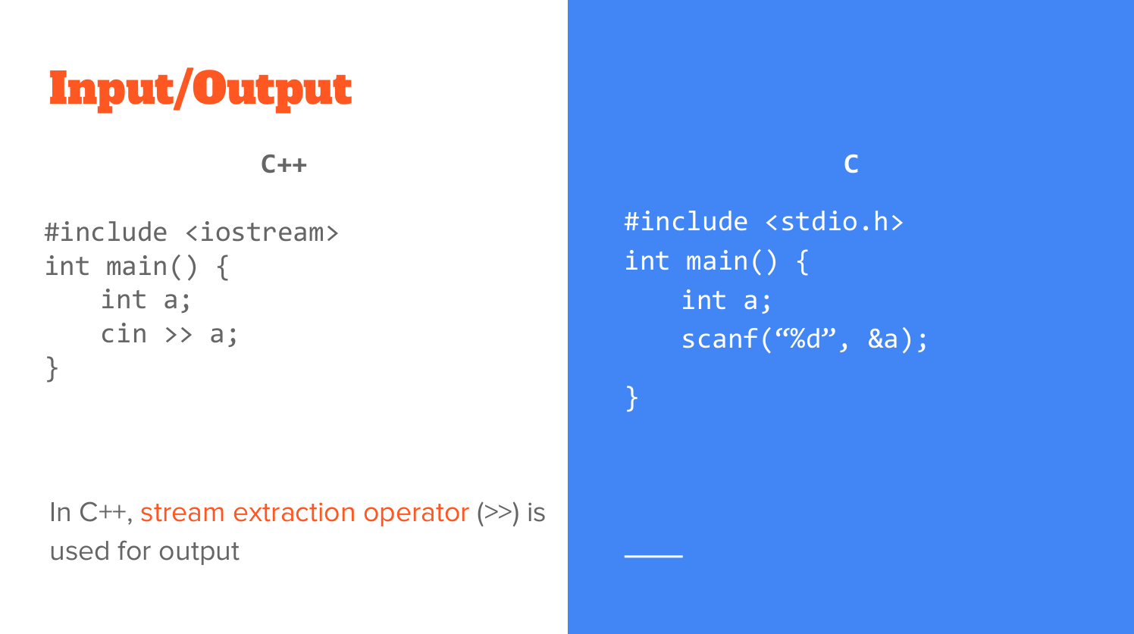

Slide 8
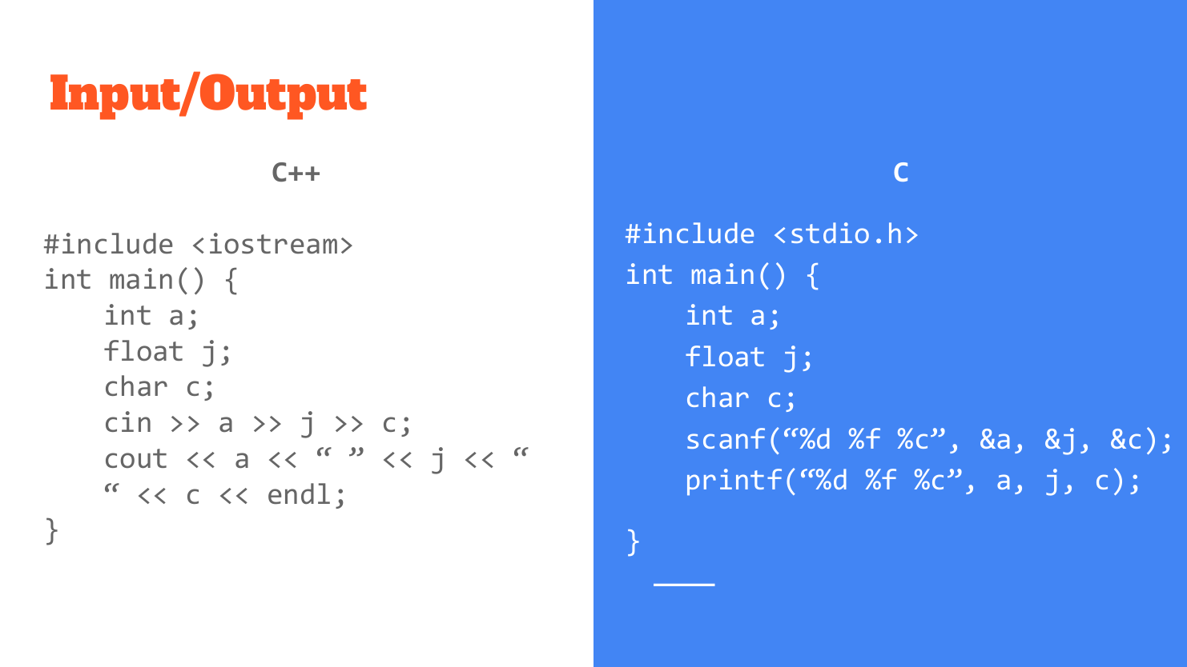

Slide 9
Namespace
Additional information to differentiate similar functions, classes, variables etc with the same name, available in different libraries.
Namespace, defines a scope. To call the namespace-enabled version of either function or variable, prepend the namespace name to the function / variable: std::cout << “hello” << std::endl;
This can be avoided with preprocessor directives: using namespace std; // std is abbreviation of namespace standard … cout <<“hello”<<endl;

Slide 10
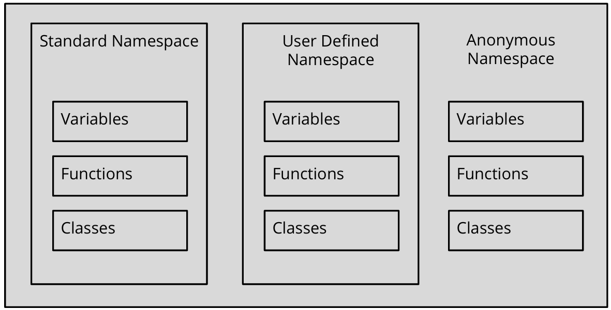
Namespace

Slide 11
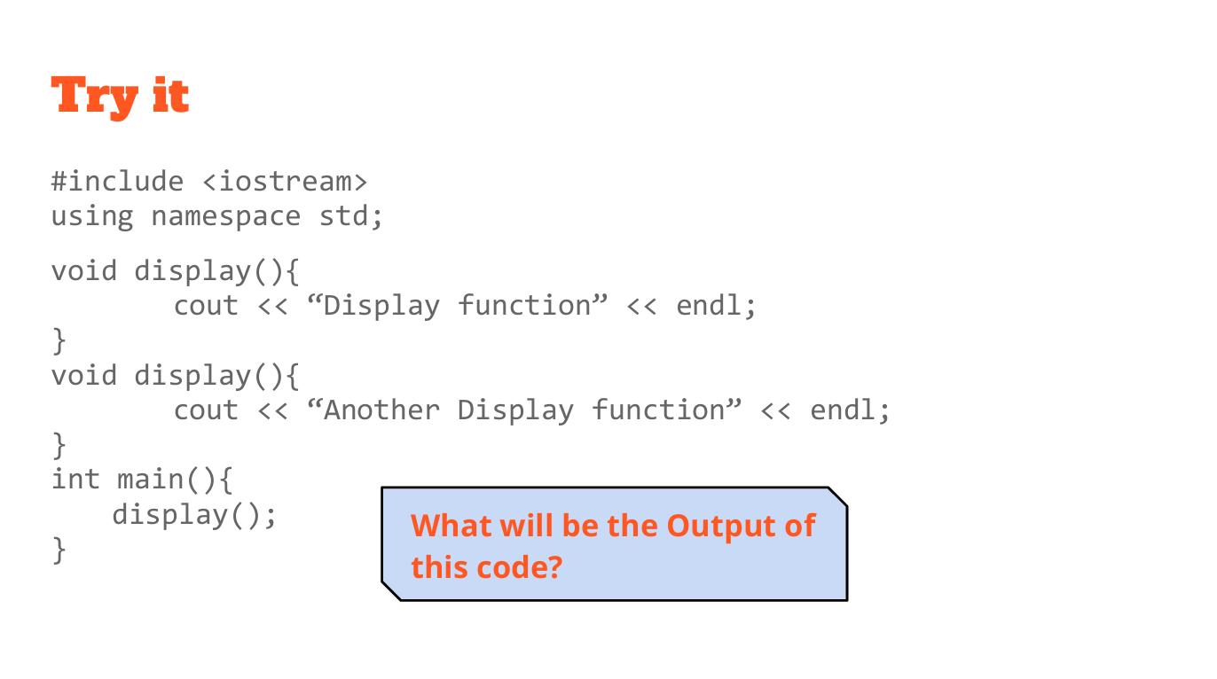

Slide 12
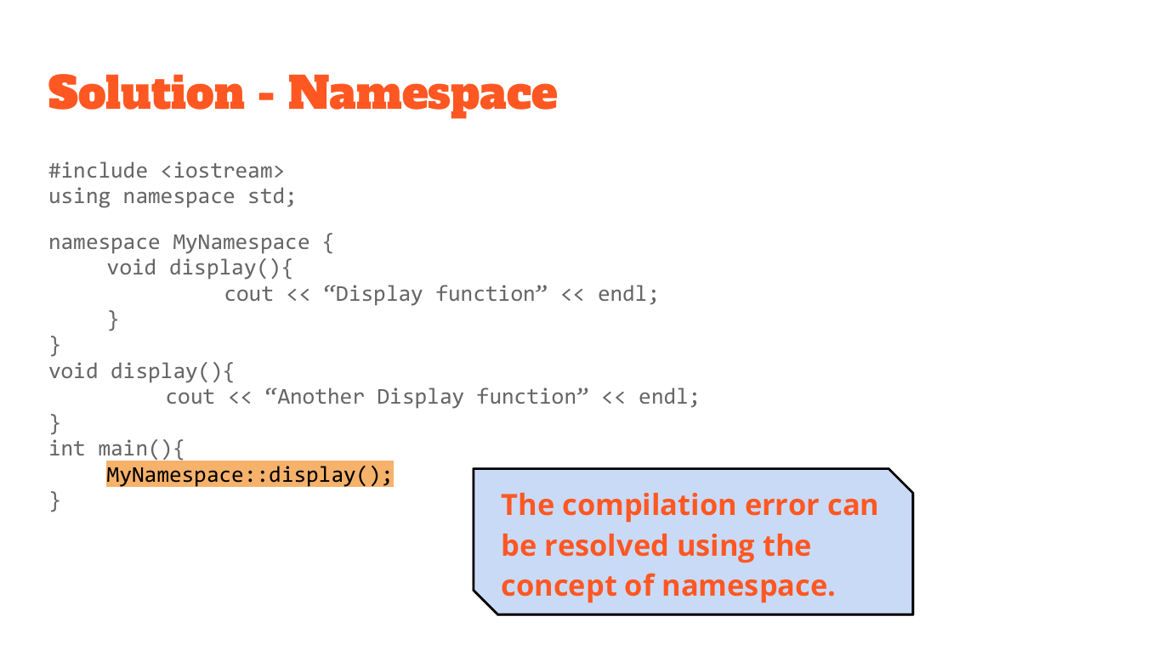

Slide 13
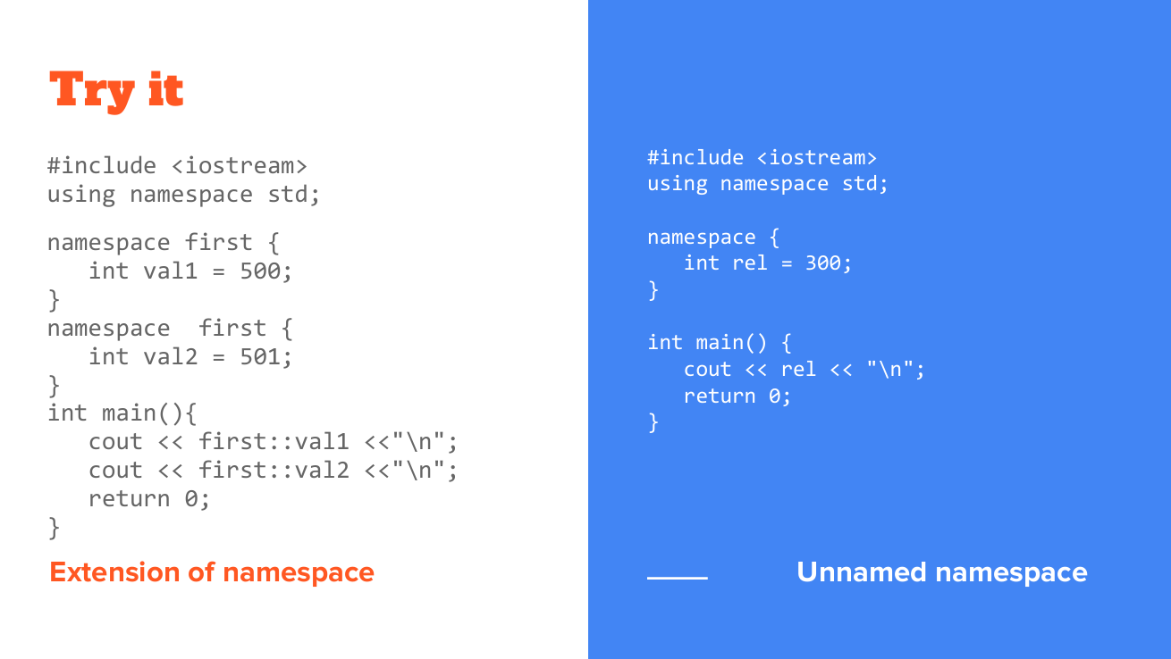

Slide 14
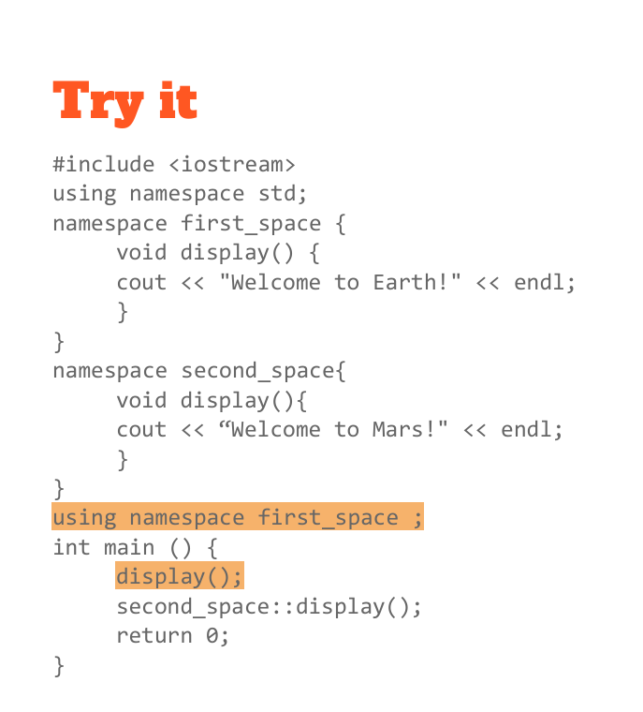
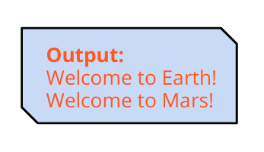
Output??

Slide 15
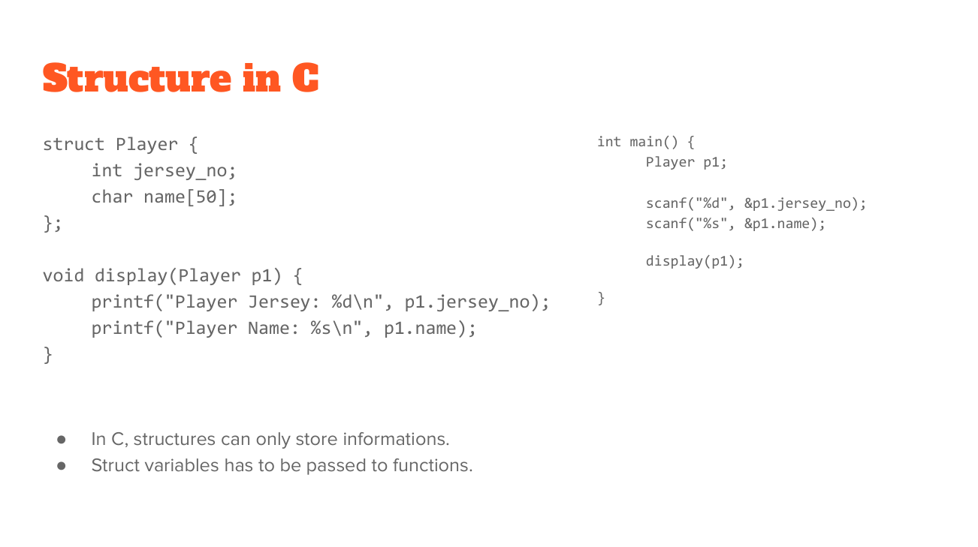

Slide 16
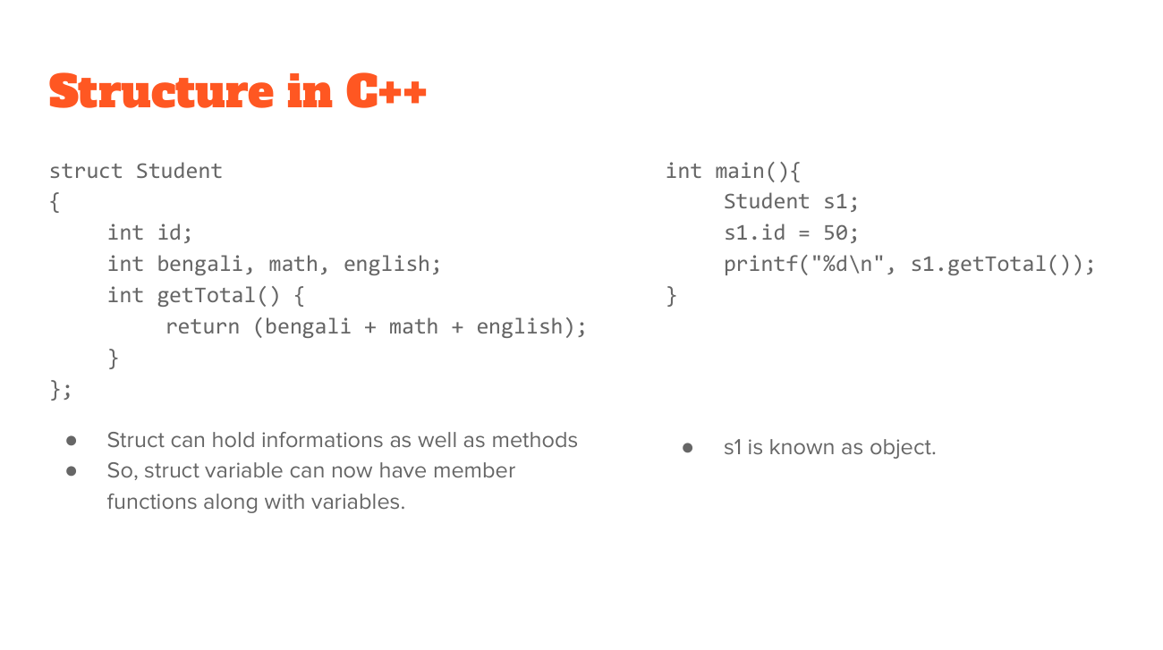

Slide 17
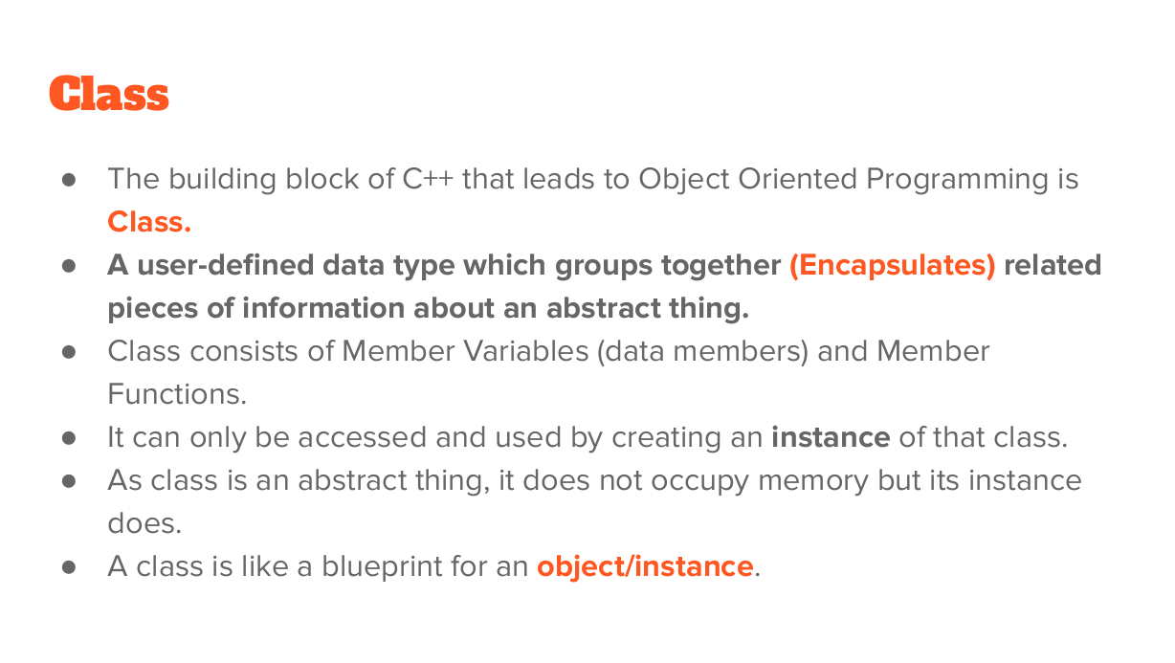

Slide 18
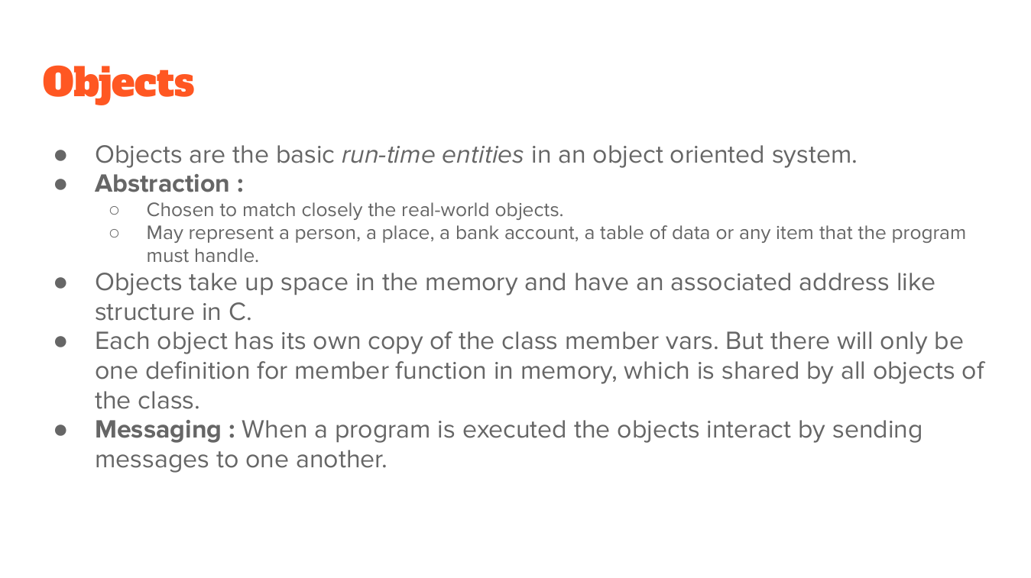

Slide 19
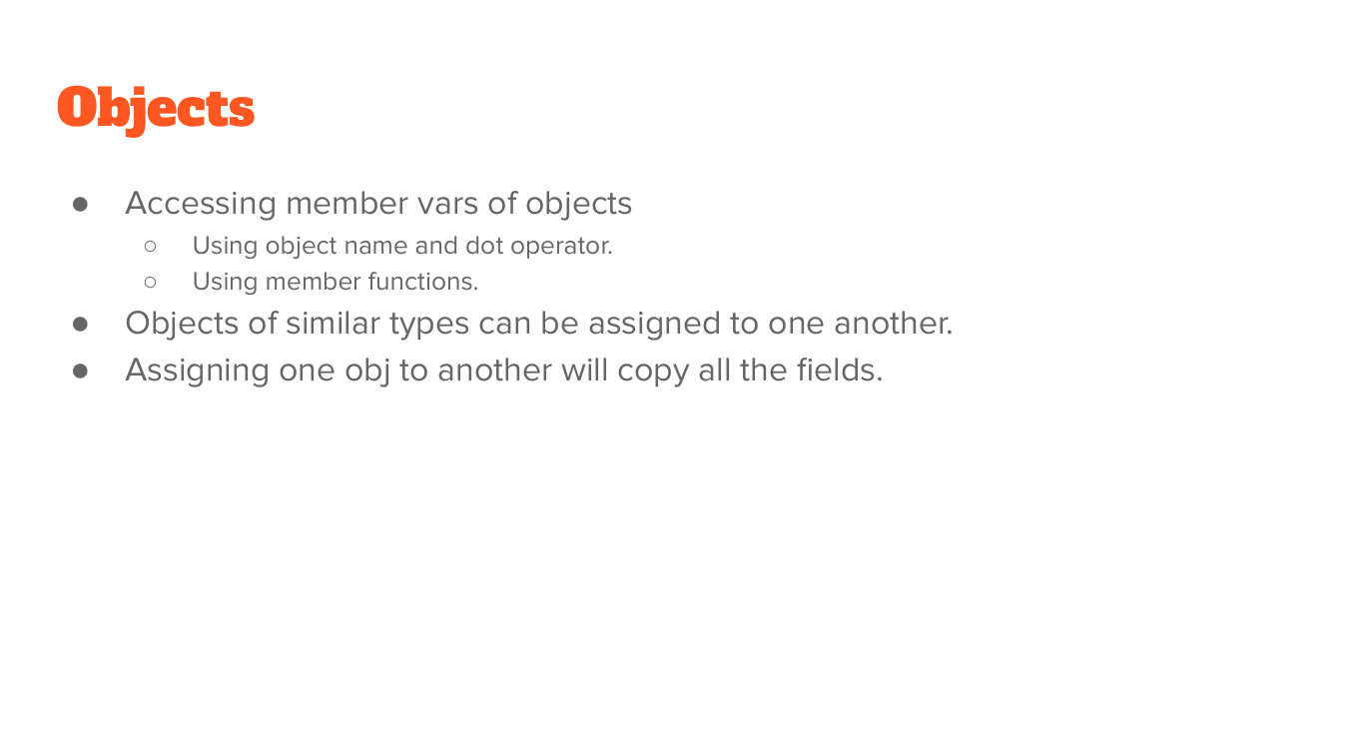

Slide 20
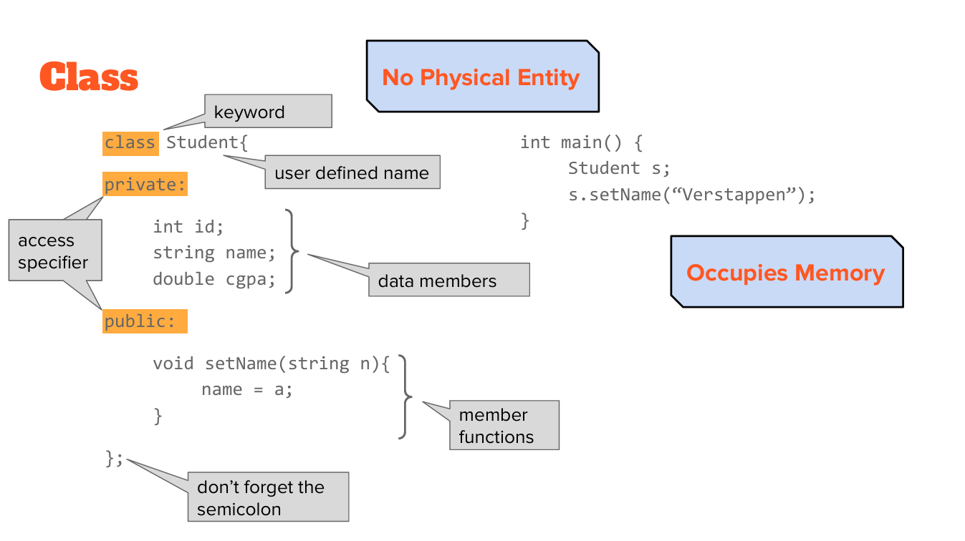

Slide 21
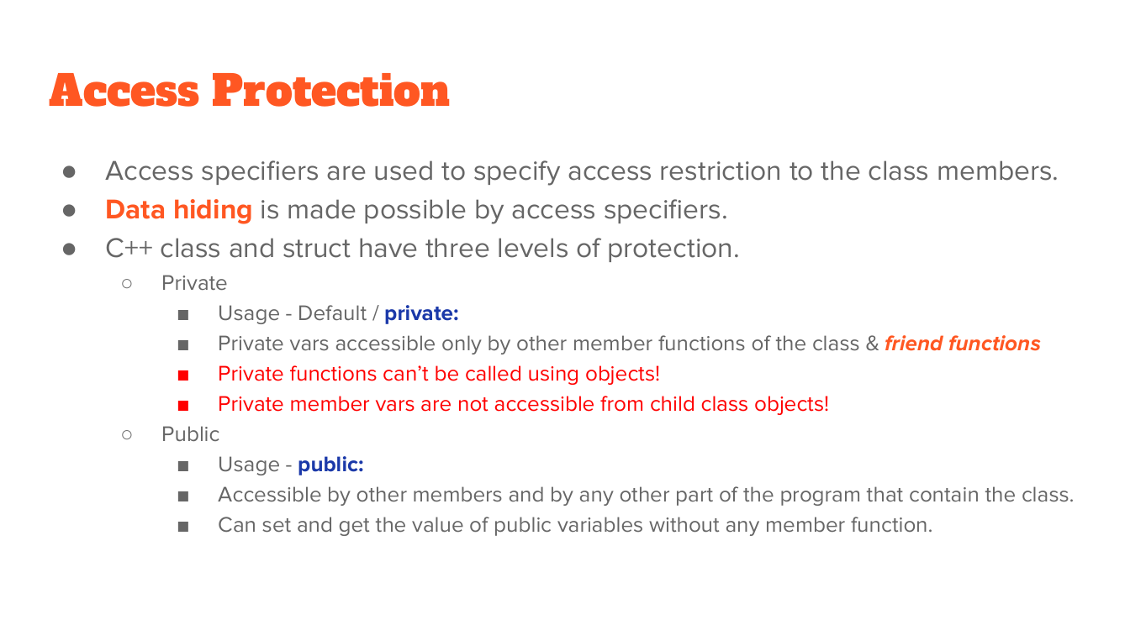

Slide 22
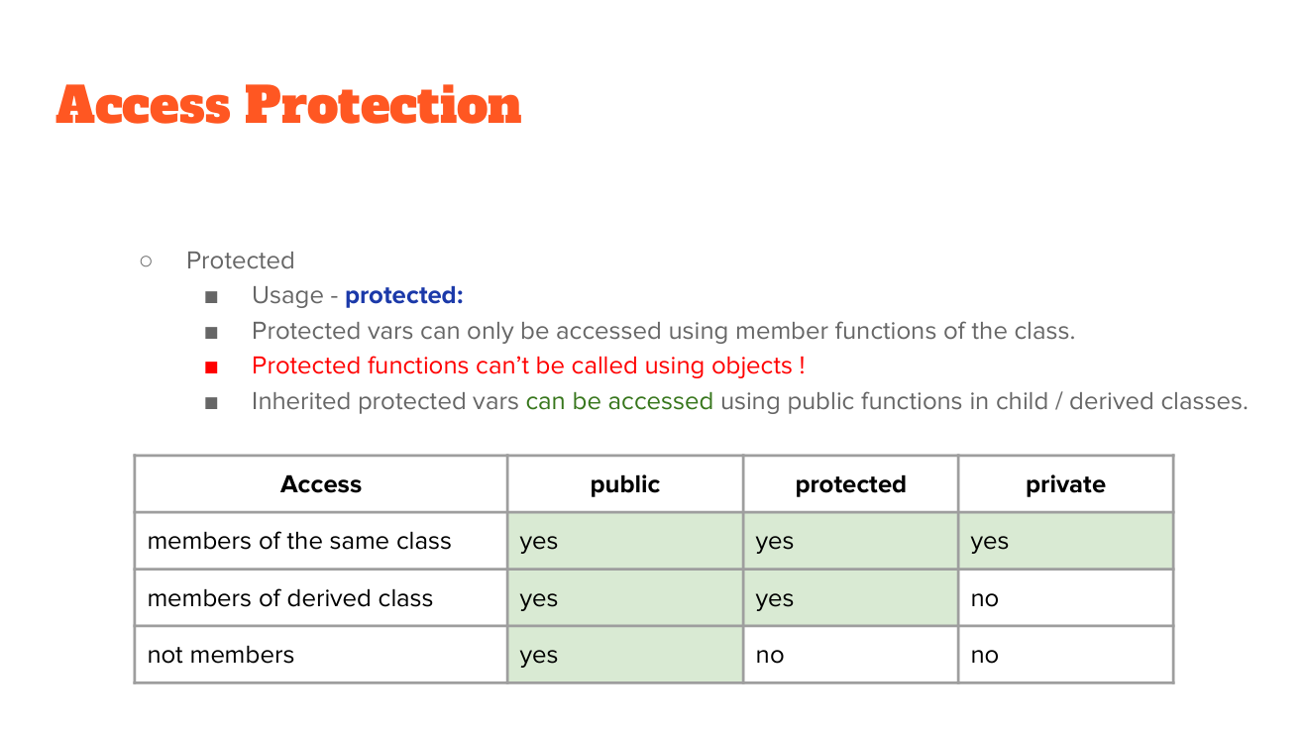

Slide 23
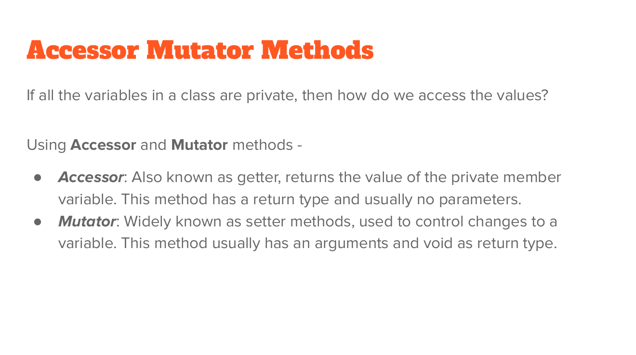

Slide 24
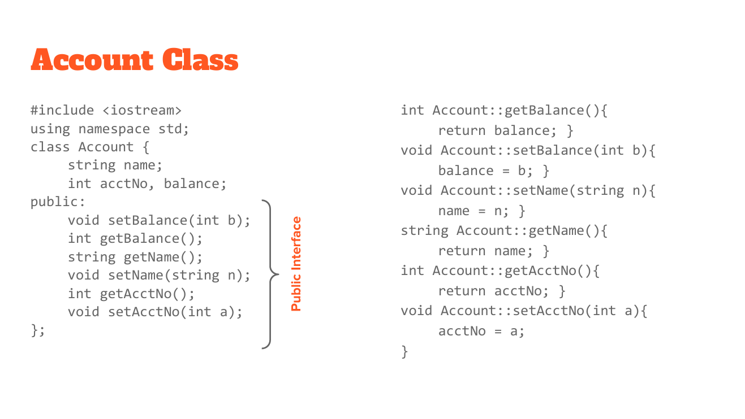

Slide 25
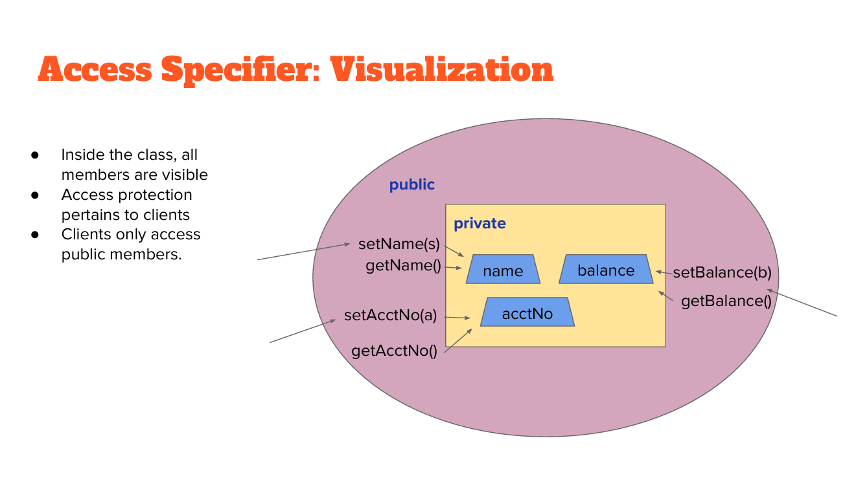

Slide 26
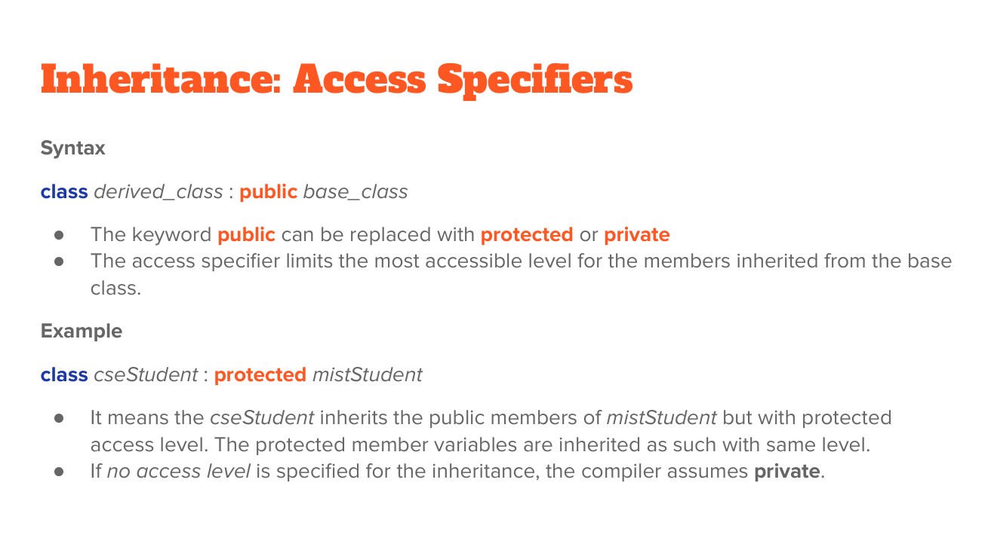

Slide 27
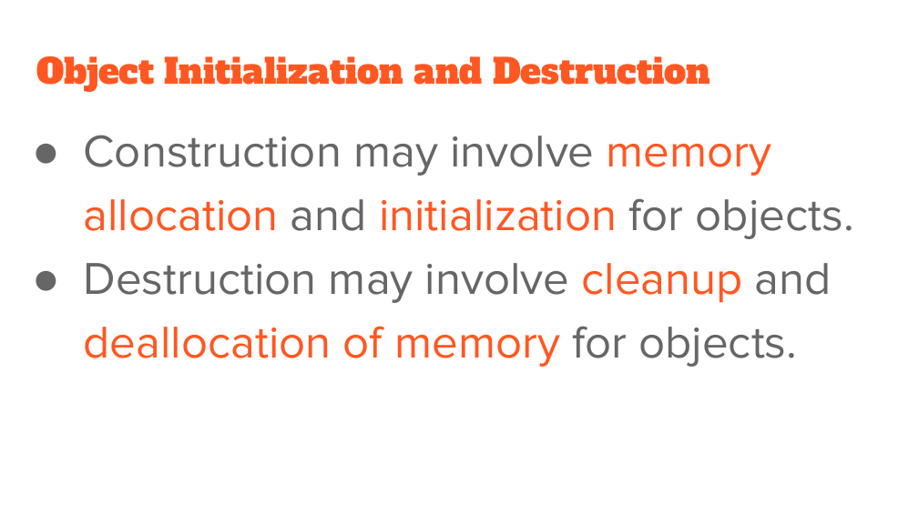

Slide 28
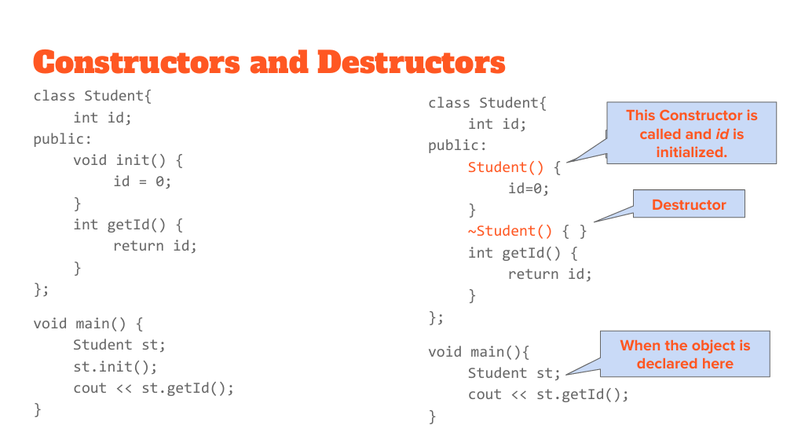

Slide 29
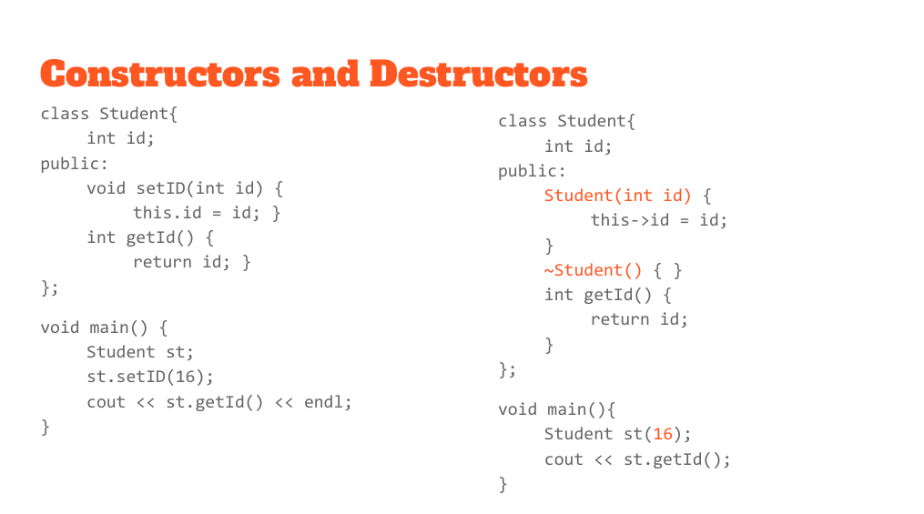

Slide 30
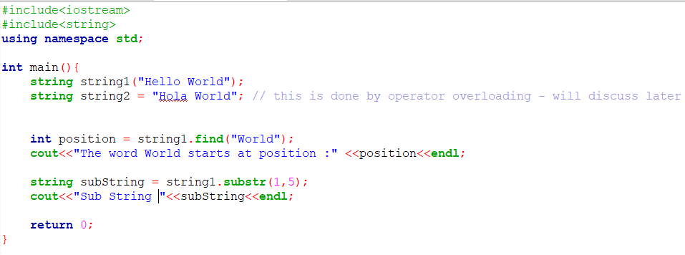
String Class

Slide 31
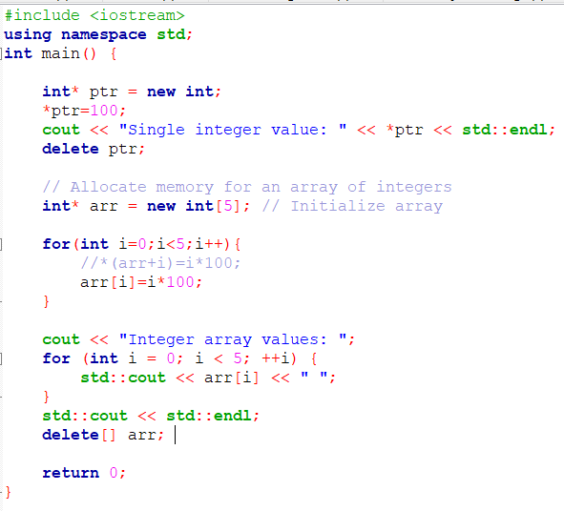
New and Delete
At first let us use it for primitive data types
Single variable
Array

Slide 32
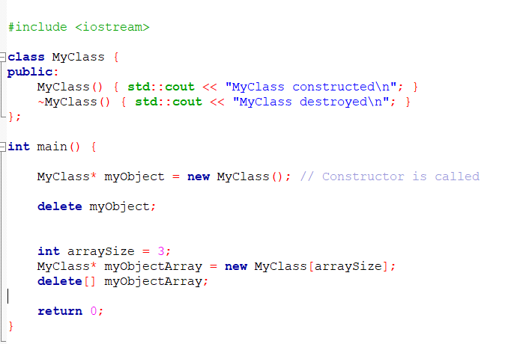
New and Delete
Now let us use it for objects
Single object
Array of objects

